Slide 1
Library
Management
System

Slide 2
Introduction
Library Management System is a Software Which can be used in any Library to record all transactions like issue book, return book , add member, update member information, update book information etc.
This software is developed using Visual Basic 6.0 as Front end Microsoft Access as back-end for storing database.

Slide 3
Existing System
The existing system contains manual records. Records were stored on paper. Difficult to search student and book record.
Updation and deletion of record is difficult regarding books students etc.

Slide 4
Scope of system
Must be able to retrieve books and member Information
Must be able to Create, add and navigate the records.
Must be able to edit existing information.
User must be able to search the record in database.
To save the lot of time.
User Friendly.
Speedy Operations.
Accuracy.

Slide 5
PROPOSED SYSTEM
To overcome the drawbacks of the current system, a new system is proposed in the form of software. All the data is inputted to the system through input forms. The data is then stored in tables in appropriate format. Whenever it is required to retrieve the data, it can be retrieved very easily as computer databases are very easy to handle.
The software is developed using Microsoft Access as Back End Software. All the Data is stored in Microsoft Access tables using Microsoft’s Visual Basic. For retrieval of data, various queries are used. The database table formats are given in appendix.
For GUI (Graphics User Interface). Microsoft Visual Basic is used as front end Software. Various forms are designed for taking inputs and for printing various reports.

Slide 6
FACT FINDING TECHNIQUES
Various fact finding techniques were used to collect detailed information about each and every aspect of the Library Management System. In order to gather and analysis the relevant information the following fact finding techniques were adopted.
Record Review and Document searching:-
We have Visited to our Library and checked records. A study of records maintained manually gave a clear idea as to how the actual process is carried out.
Interviews:-
Timely discussions with Mrs. S. S. Gajbe(Librarian at our college) was made to understand the exact requirements of the system. These discussions were also useful in bringing up new ideas as to make system more effective. Through such invaluable techniques, it is possible to find much of the quality.

Slide 7
FEASIBILITY STUDY
1.Technical Feasibility : Library Management system uses the concept of paperless transactions. Also, storing and searching of the book records is very accurate, reliable and is following all the rules for the same. Adding new Members And books to Library System is very easy. The time required for the proposed system very negligible as compared with the manual system, we can say that the proposed system is technically feasible.
2.Economical Feasibility : For maintaining Books Transaction Records manually requires different types of documents, registers, member cards etc. But with our new software system this cost is reduced. So we can say that the system is economically feasible.
3. Operational Feasibility: Our Software System is very Simple And Powerful. Any person Can Handle It.
1. It helps to prepare clearly understandable and faster transactions of book records .
2. With appropriate error messages for every screen this makes the system easy for librarian and user and very easy to operate any person.

Slide 8
Software Requirement
Operating System :- Microsoft Windows XP & Higher
Front End :- Microsoft Visual Basic 6.0
Back End :- Microsoft Access

Slide 9
Hardware requirement
Intel i3 Dual Core.
RAM 1 GB.
HDD 50 GB.
Printer.

Slide 10
ENTITY RELATIONSHIP DIAGRAM
UserID
Password
ID
Login
Authentication
System
Name
Admin
Password
Maintain
Keep Track
B_ID
ID
Author
Phone No
Issue
Books
Member
B_Name
Return
Price
Name
Address

Slide 11
Context Level DFD
Library Management System
Book Enquiry
0.0
Member
Returns Book
Report
Admin
Book Details
Book Issue
Query

Slide 12
1 st Level DFD
Master Report
Admin Detail
1.0
Book Information
Admin
Book Details
Admin Information
Admin Details
Member
Member Detail
Member Information
Member Details

Slide 13
Book Search
2.0
Book Information
Book Details
Enquiry of
Book
Member
Book Status

Slide 14
Book Issue
3.0
Book Information
Book Details
Request Book
Member
Transaction Information
Transaction Details
Issue Book

Slide 15
Book Return
4.0
Pay Fine
Book Information
Book Details
Return Book
Member
Transaction Information
Transaction Details
Fine Information
Fine Details
Fine Details

Slide 16
Report Genration
BookInformation
5.0
Book Details
Query
Member Info
Member Details
Admin
Transaction Info
Trans Details
Order Info
Issued Details
Report Information

Slide 17
Form Design

Slide 18
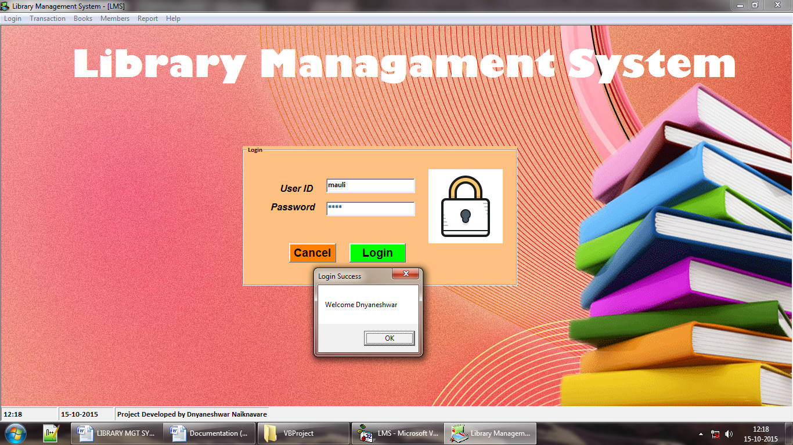
Login form

Slide 19
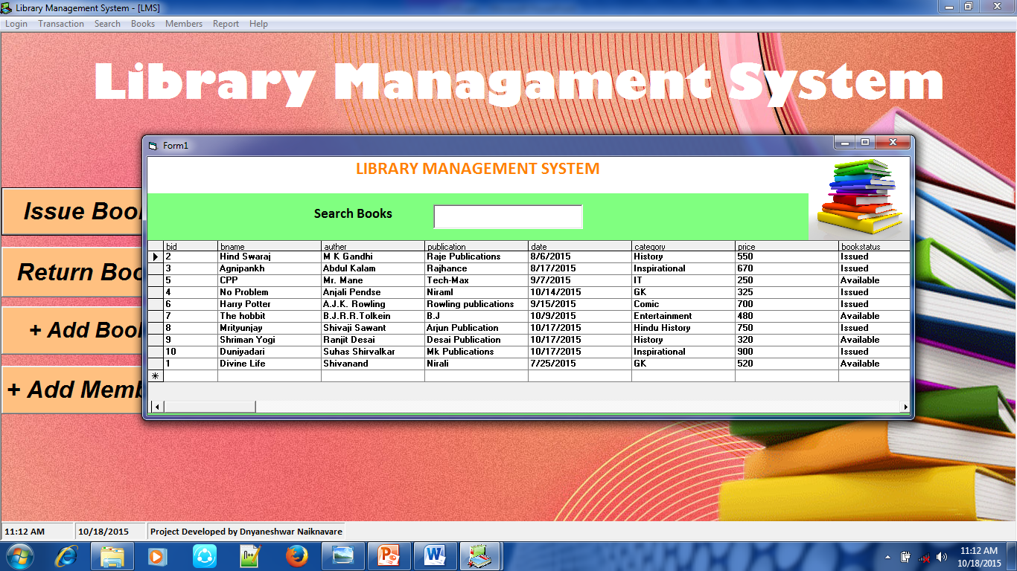
Search book

Slide 20
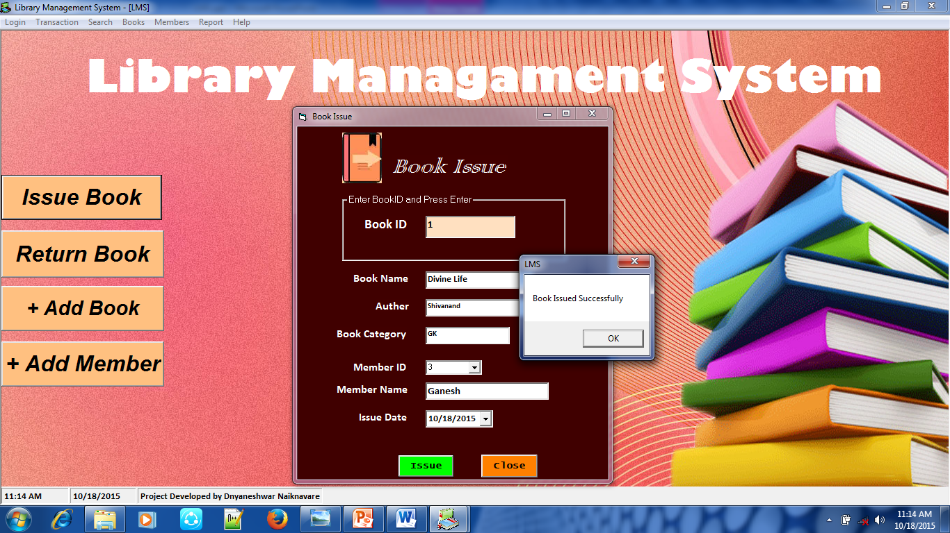
Issue book

Slide 21
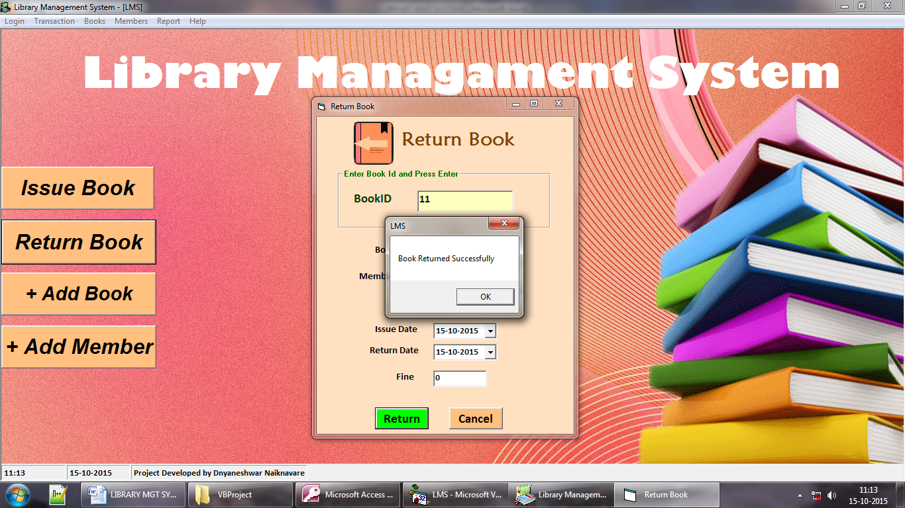
return book

Slide 22
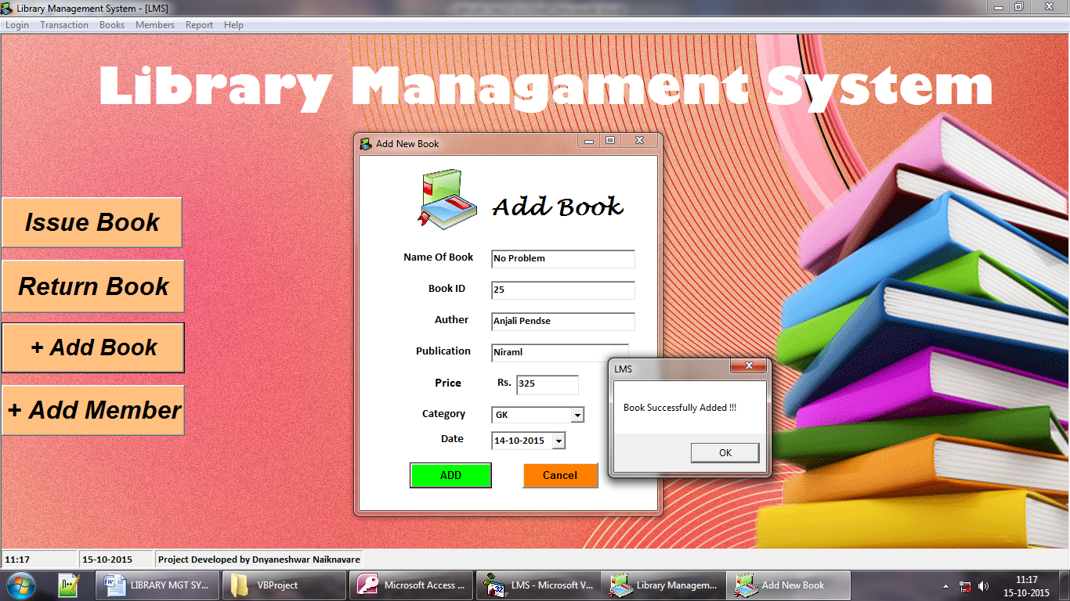
add book

Slide 23
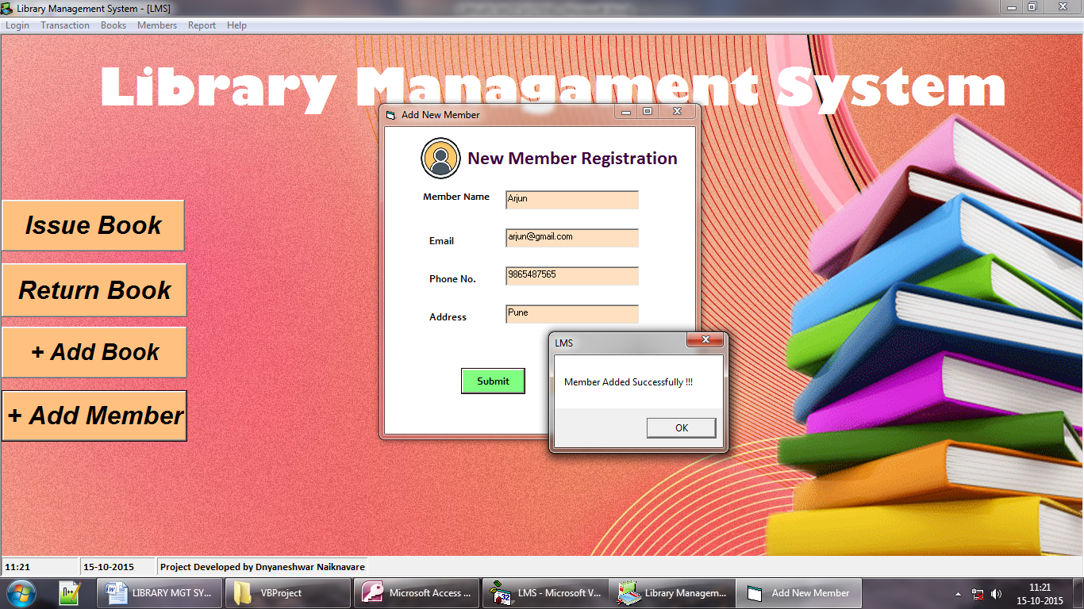
Member Registration

Slide 24
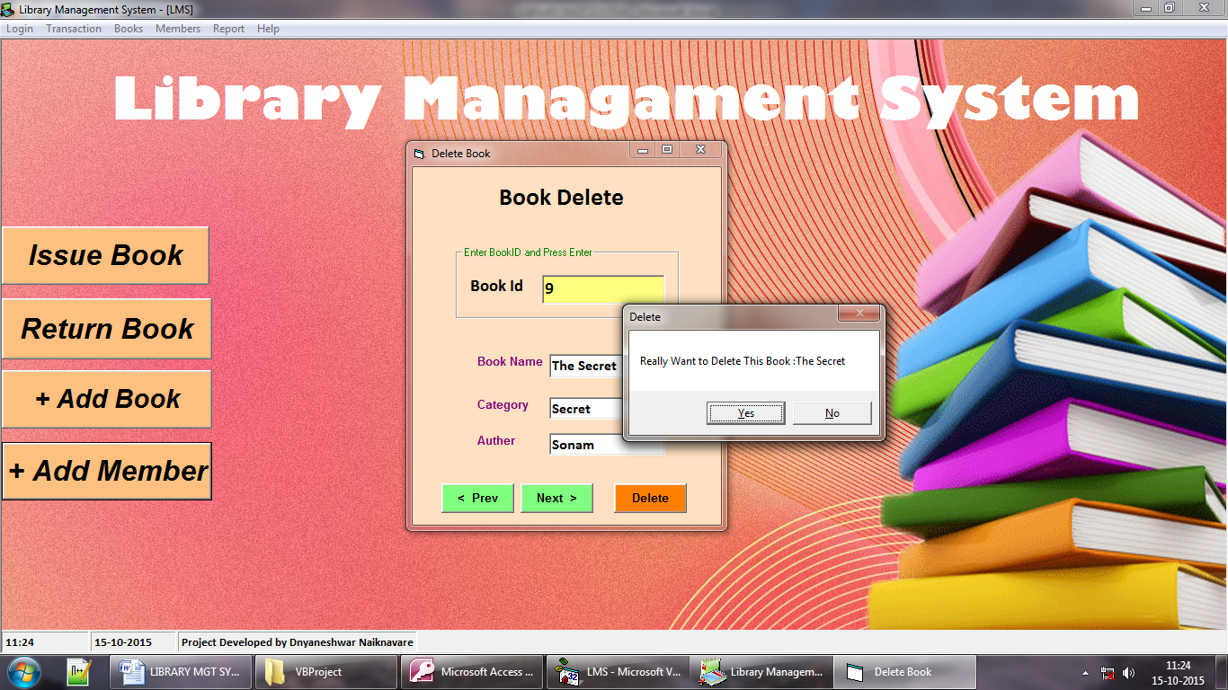
delete book

Slide 25
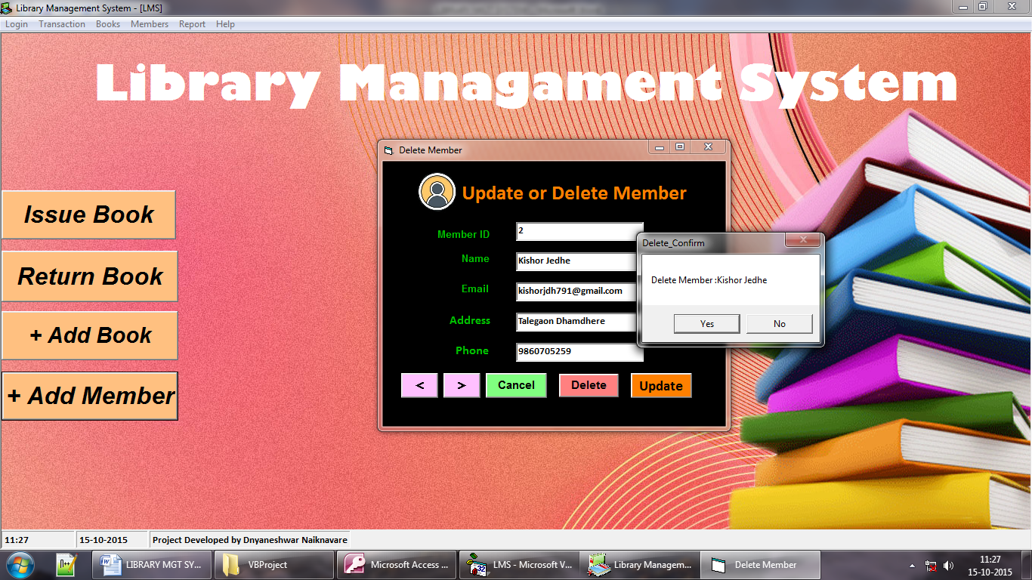
Delete & update member

Slide 26
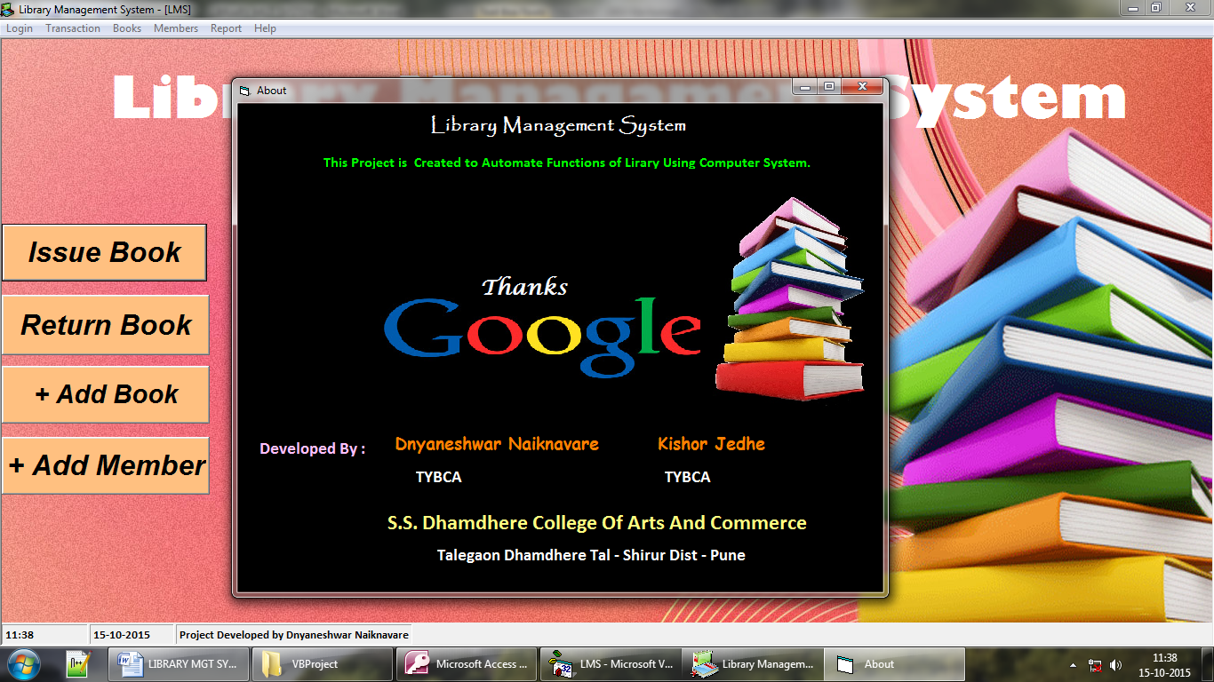
About form

Slide 27
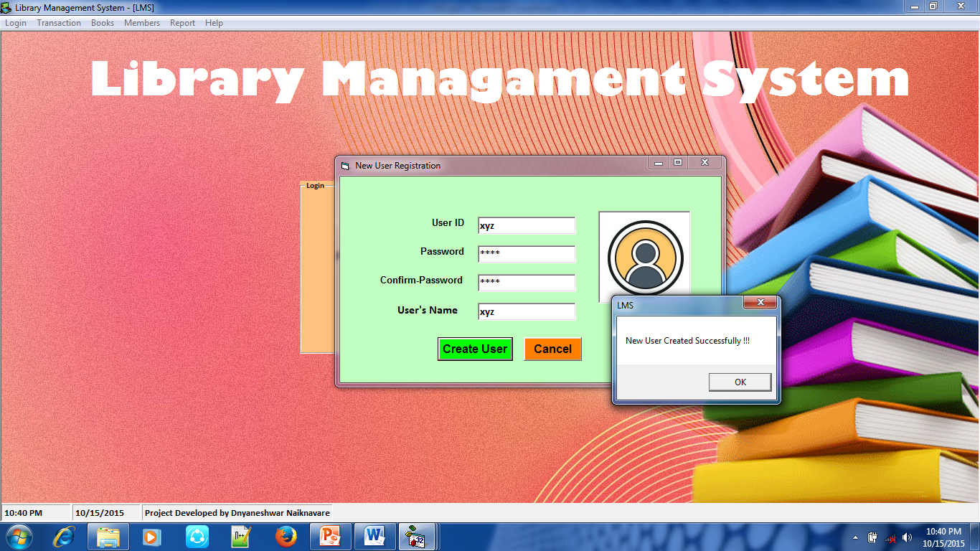
New user registration

Slide 28
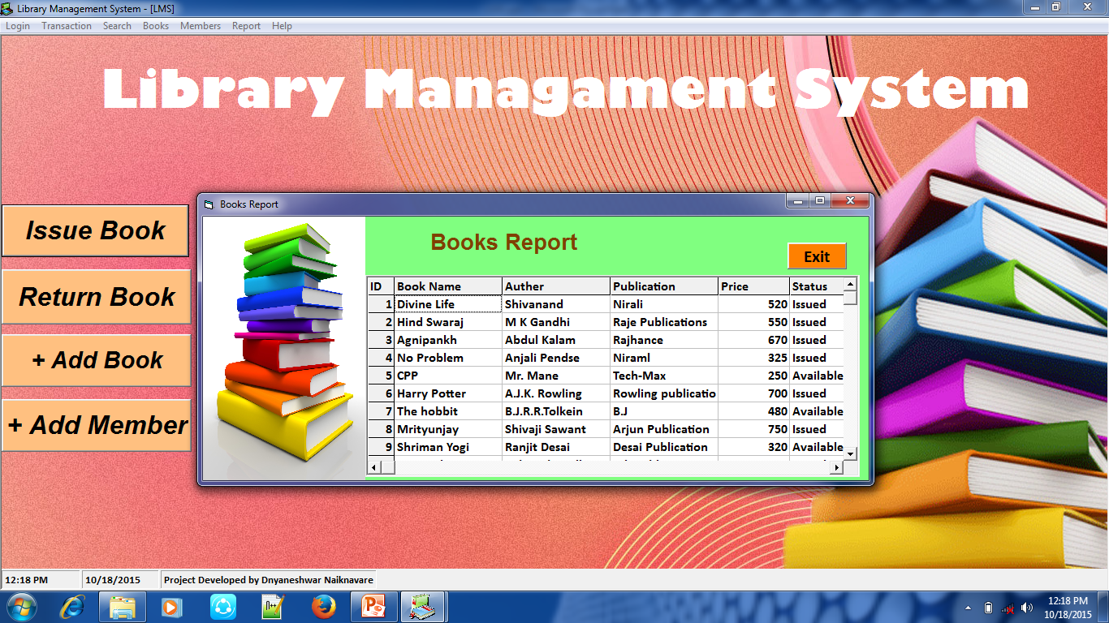
Book report

Slide 29
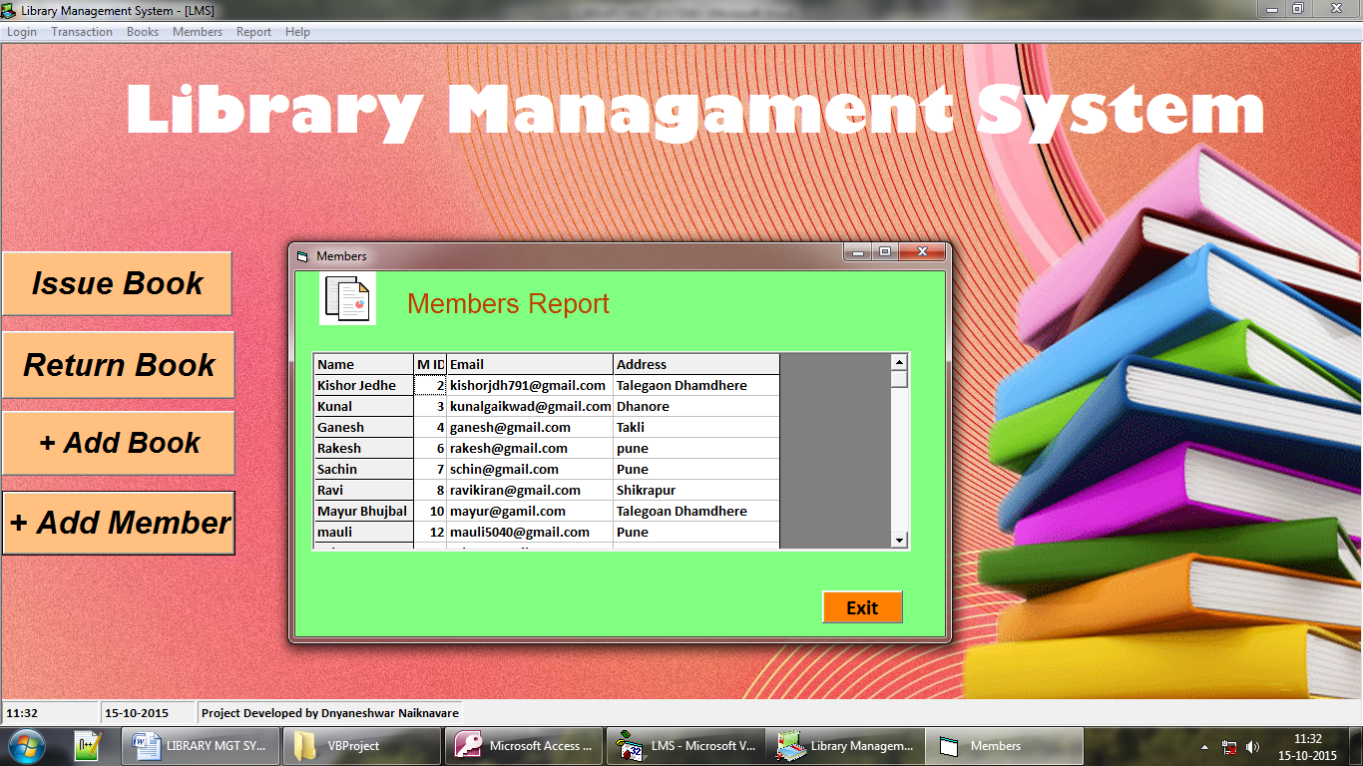
Member report

Slide 30
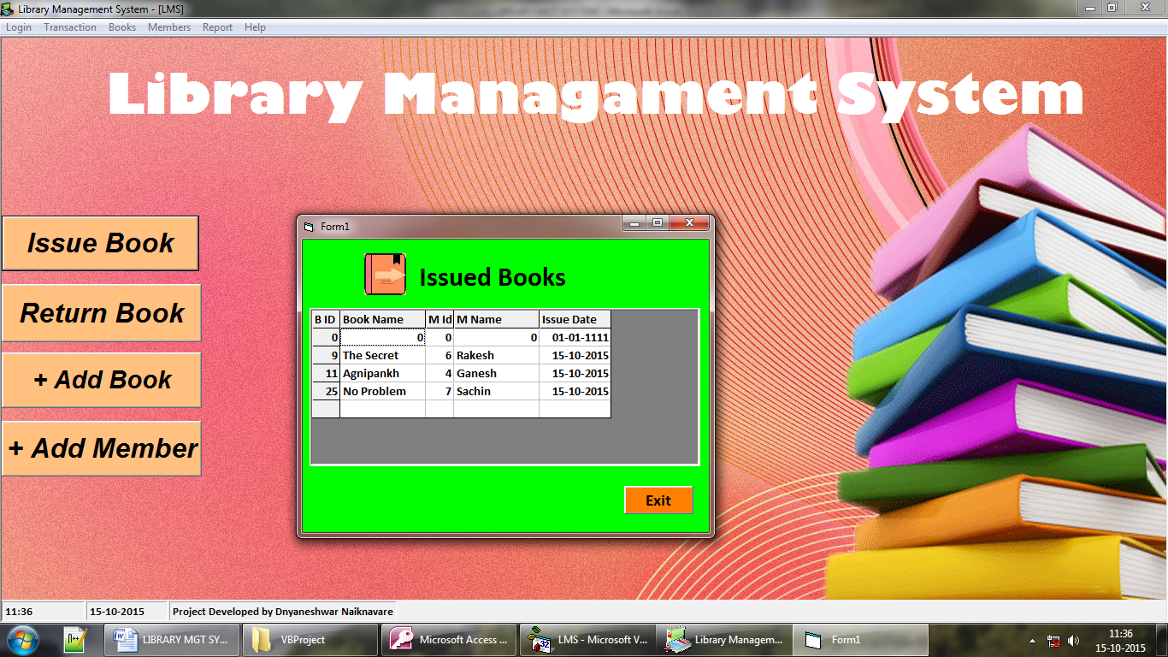
Issued book report

Slide 31
advantages
User friendly:
The system got much simplified screen which makes the system facts enhance quick and accurate data.
Validation check:
The system has various validation check and it also gives
Appropriate error message and necessary help.
Report generation:
The system can generate various reports giving book & member details.

Slide 32
limitations
1. This project is not online

Slide 33
enhancements
Although there are no more drawbacks of this system following are the possible enhancement of this system.
Enabling this system for multi-user environment and networking, so that multiple administrators can handle system from multiple places.
Instead of using access as back end, Oracle or SQL Server is proposed back end so that manipulation of large data becomes easy and efficient due to RDBMS.

Slide 34
conclusion
Working on this project was a good experience. Working together in a team helped to communicate better. We understood the part of designing & planning as a part of software development.
With this we come to the end of our project documentation. Hope it would serve all the requirements needed to understand the system. Hope to get your feedback for further improvements.

Slide 35
BIBLIOgraphy
Advanced Visual Basics 6.0
Visual Basics Black Book.
Same Teach Yourself Visual Basic 6.0 in 21 Days.
Websites
www.google.co.in
www.tutorialspoint.com
www.shriwebworld.in

Slide 36
Presented By
Kishor Jedhe &
Dnyaneshwar Naiknavare

Slide 37
Thank You !!!

